Slide 1

CSE 314 - Digital Image Processing
Term Project
Miran Tafazzul Hussain Junaidi
Junior Year, Computer Science and Engineering - B
AP17110010074
Miran Tafazzul Hussain Junaidi, AP17110010074

Slide 2
Problem at Hand
Due to the coronavirus Pandemic, Over 3 quarters of a million people are infected and over a quarter of a hundred thousand people died.
Because of such a large volume of cases, it is becoming very difficult to test so many people for coronavirus in a given timeframe. Testing the mass is a huge issue
Miran Tafazzul Hussain Junaidi, AP17110010074

Slide 3
Aim and introduction
we are building a Machine Learning model to classify images of chest X ray from different angles into whether those X rays have lung abnormalities which arise due to the effect of Coronavirus.
We will be building a conventional convolutional Neural Network and train it on around 300 images and validate it with around 100 Images.
Miran Tafazzul Hussain Junaidi, AP17110010074

Slide 4
Aim and introduction
we are building a Machine Learning model to classify images of chest X ray from different angles into whether those X rays have lung abnormalities which arise due to the effect of Coronavirus.
We will be building a conventional convolutional Neural Network and train it on around 300 images and validate it with around 100 Images.
Miran Tafazzul Hussain Junaidi, AP17110010074

Slide 5
Data Engineering
The data was taken from the following sources
Kaggle Chest X Ray Images of Pneumonia (Normal Images used) - Link
Covid Infected Chest X-Ray Images taken form this IEEE Repository
This Data was then arranged to a particular structure in the disk locally
Miran Tafazzul Hussain Junaidi, AP17110010074

Slide 6
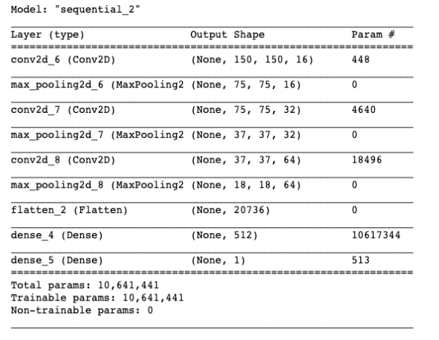
CNN - Model
We designed a convolutional Neural Network with the following Architecture
Miran Tafazzul Hussain Junaidi, AP17110010074

Slide 7
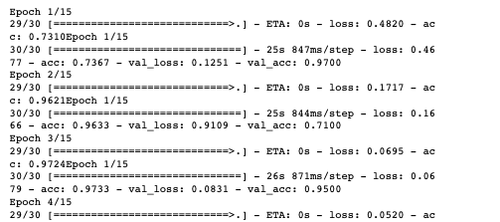
Training and Accuracy
We then trained the model with the Image Data generator which load the images from the directory. This is the training information
Miran Tafazzul Hussain Junaidi, AP17110010074

Slide 8
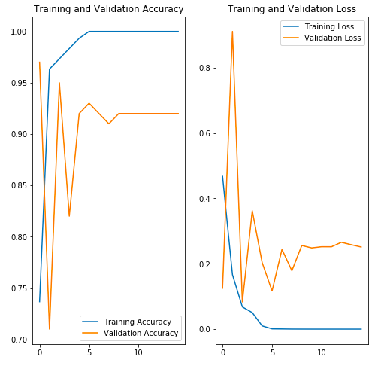
Accuracy
After training the Model on the Data, the following results were obtained
Accuracy Plot :
Miran Tafazzul Hussain Junaidi, AP17110010074

Slide 9
Loss Function
After training the Model on the Data, the following results were obtained
Loss function Plot :
Miran Tafazzul Hussain Junaidi, AP17110010074

Slide 10
Result and Conclusion
We have accomplished the initial aim of the Project. We have successfully built an image classifier which classifies a given chest X-Ray Image as to whether or not the person with that X-Ray is suffering from Pneumonia due to COVID-19.
We achieved a great accuracy with a test accuracy of 92% and with a loss of the scale 10⁻⁶ which is pretty fine. This model can be used to predict now.
Miran Tafazzul Hussain Junaidi, AP17110010074

Slide 11
Thank You
Miran Tafazzul Hussain Junaidi, AP17110010074

Slide 12
Appendix
Miran Tafazzul Hussain Junaidi, AP17110010074

Slide 13
Important Links
Here are more Important Links to the entire Project
Entire Project Write Up attached with the PPT
Github Repository of the course
Project Repository
Code Archive - Jupyter Notebook for the Project Code
Tree Structure of the Dataset
Miran Tafazzul Hussain Junaidi, AP17110010074

